Slide 1

FitFlash Women
“Empowering Busy Women to Prioritize Health & Fitness"

Slide 2




Why Choose FitFlash Women

Slide 3
Key Features
User Authentication
Blog Posts
Workouts and videos

Slide 4
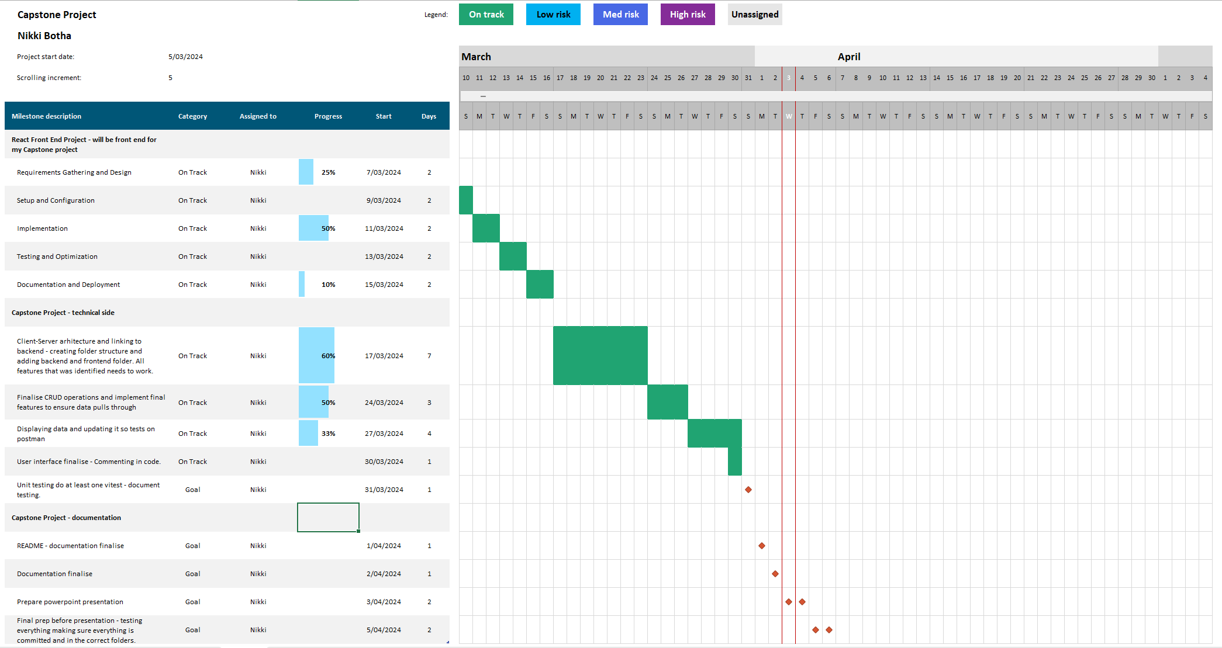

Slide 5
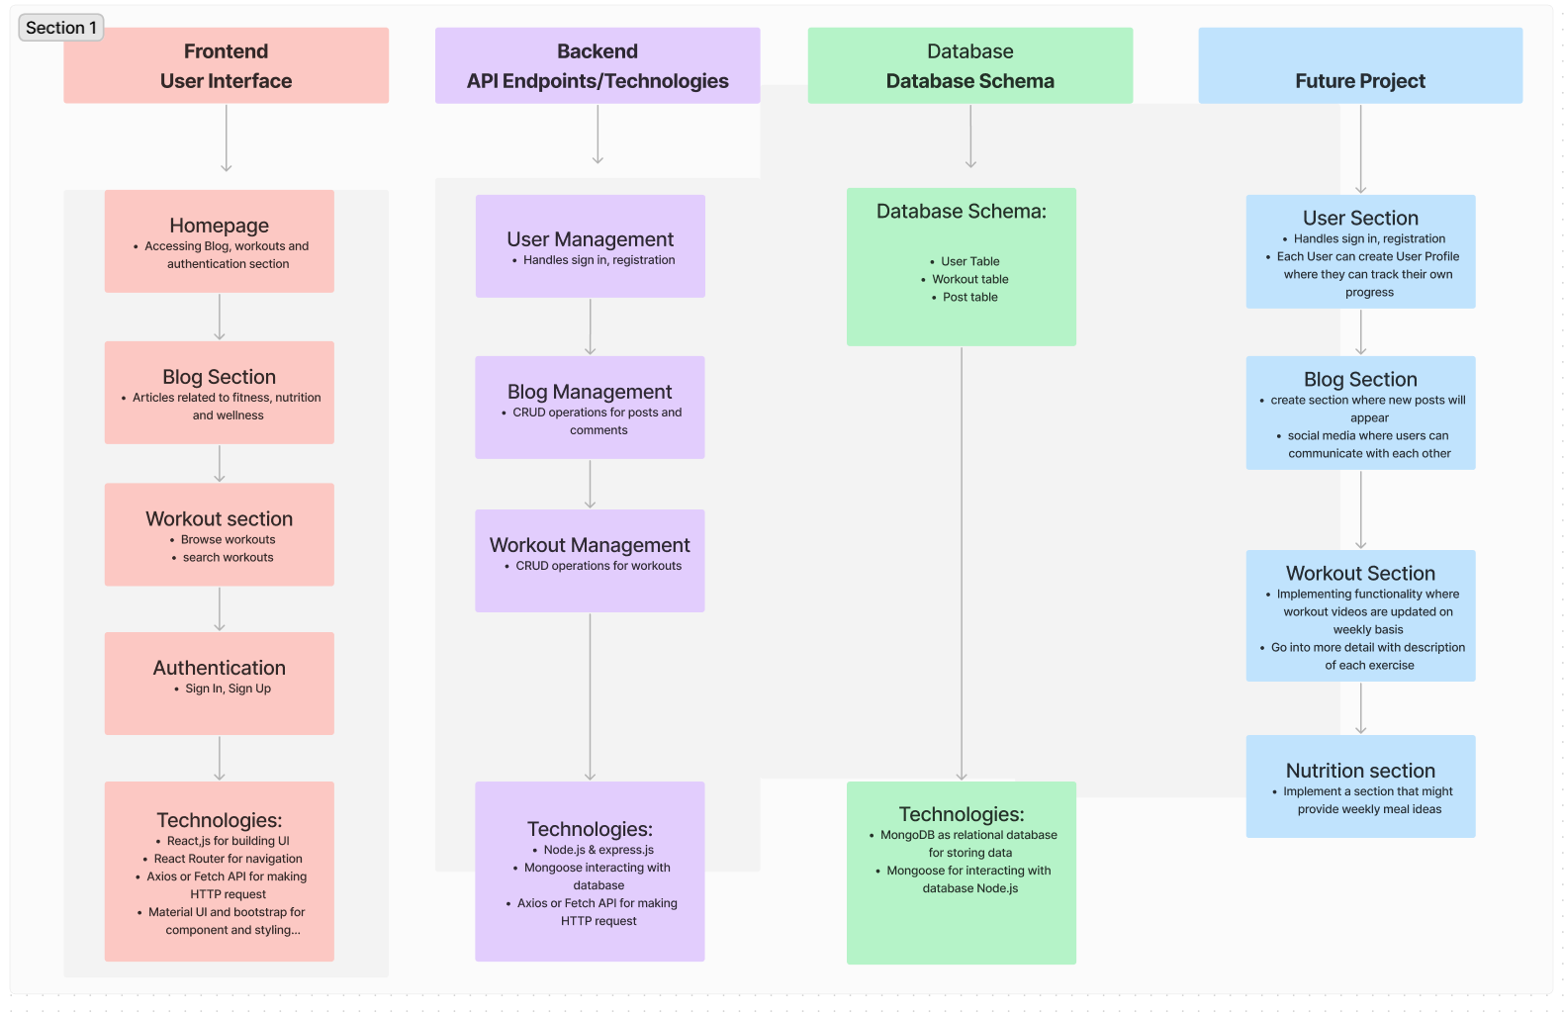
System Design Overview

Slide 6
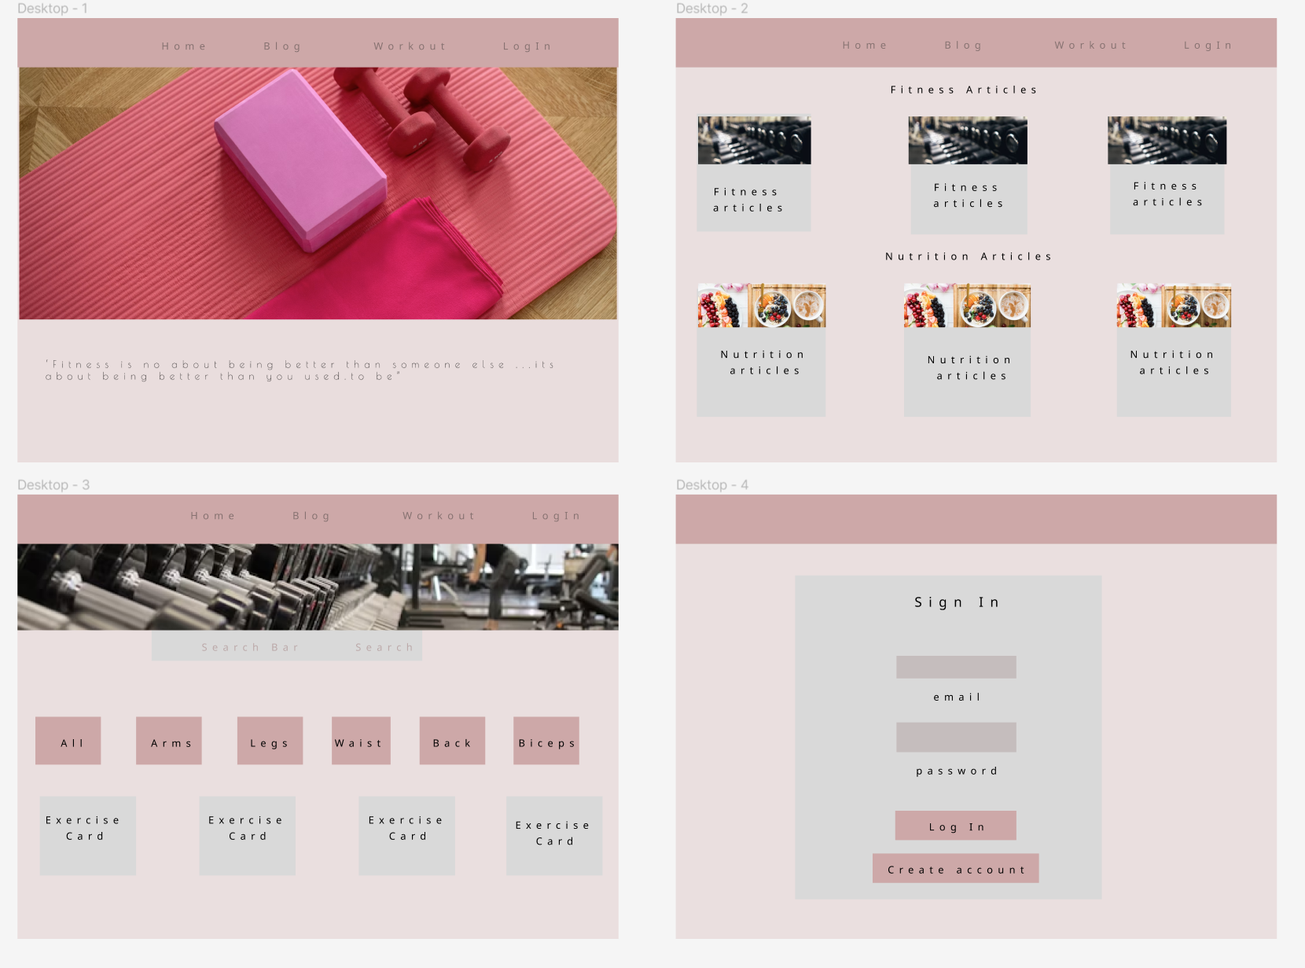
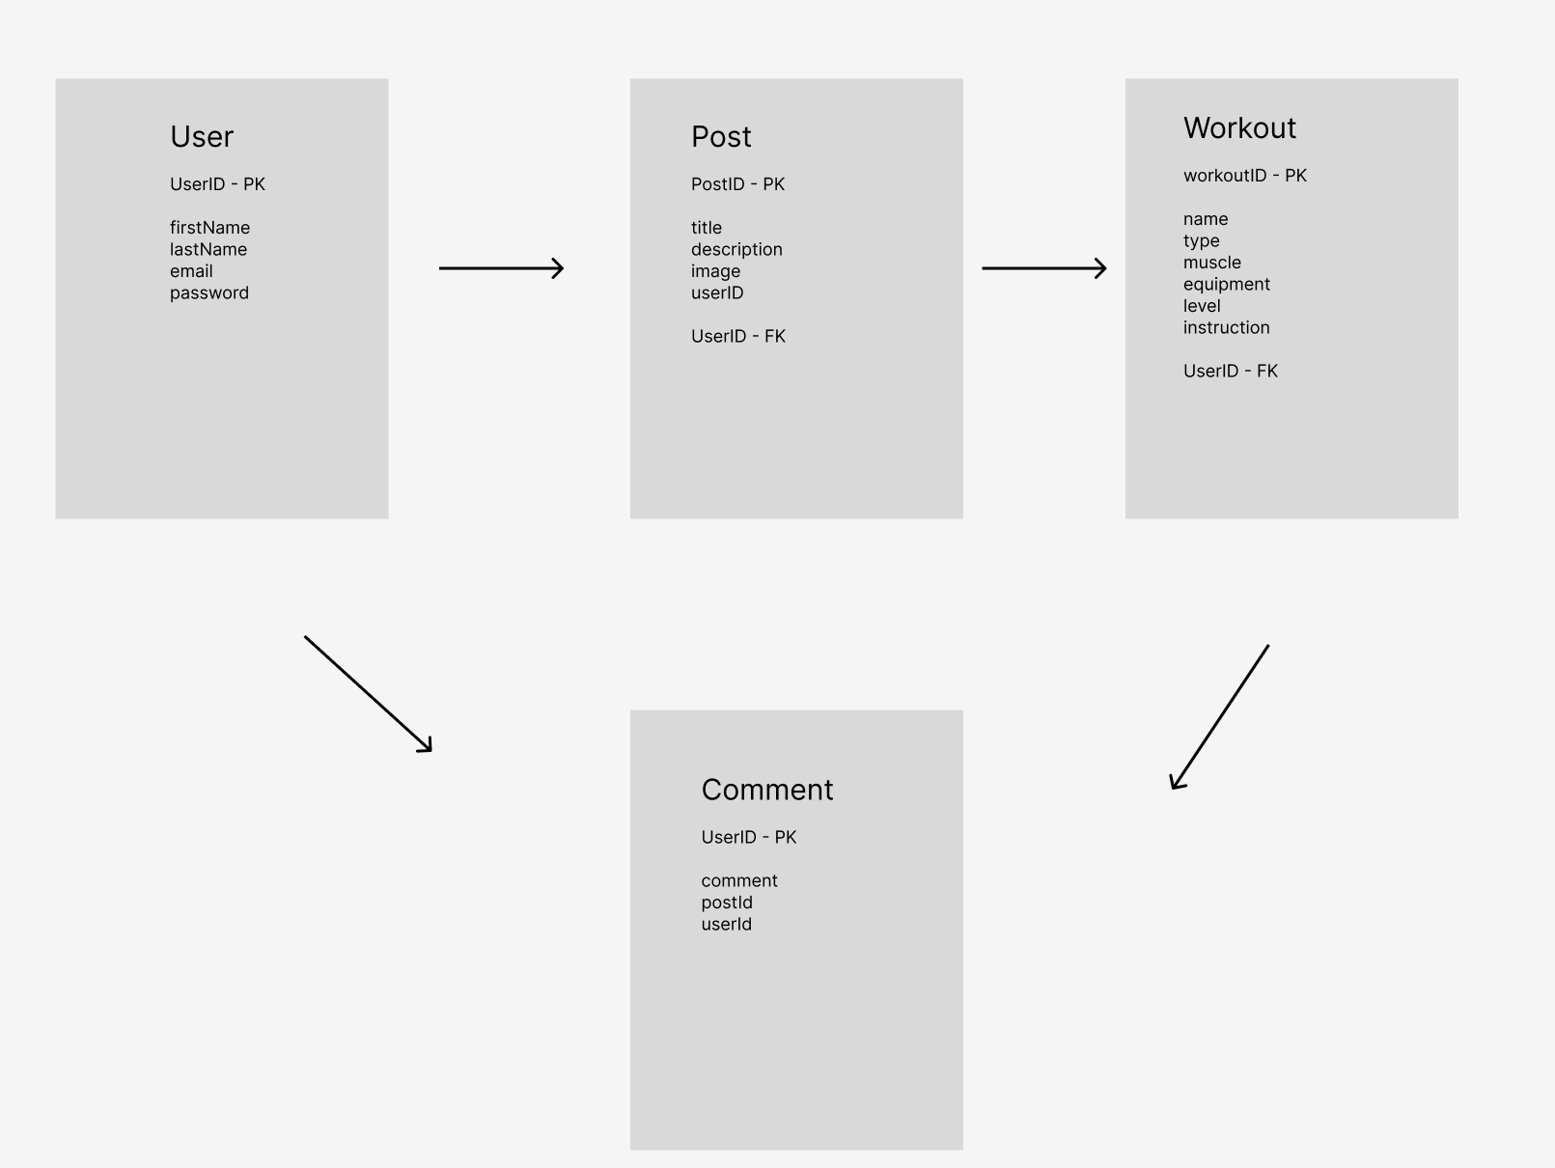
Design Overview

Slide 7

FitFlash App

Slide 8
Thank you!!

